Slide 1
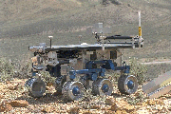
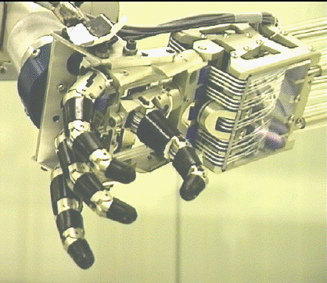
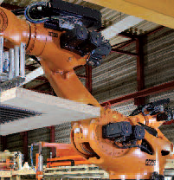
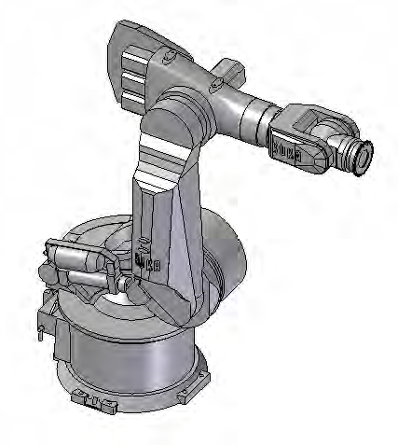
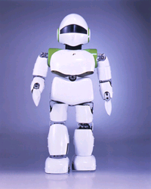
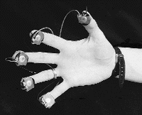
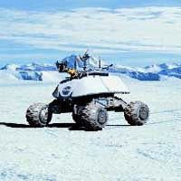
Foundation on Robotics

Slide 2
What is a robot?

Slide 3
ROBOT
R -
O -
B -
O -
T -

Slide 4
A Robot is:
An electromechanical device that is:
Reprogrammable
Multifunctional
Sensible for environment

Slide 5
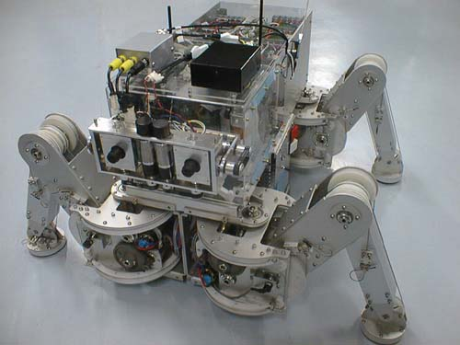
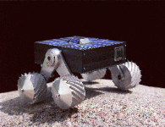
What is a Robot: II
Legged Robot
Wheeled Robot

Slide 6
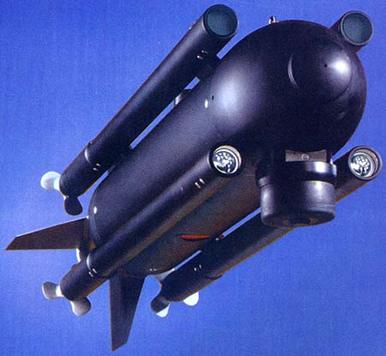
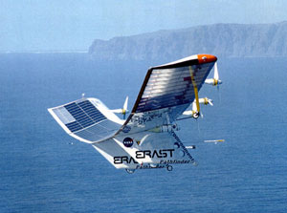
What is a Robot: III
Autonomous Underwater Vehicle
Unmanned Aerial Vehicle

Slide 7
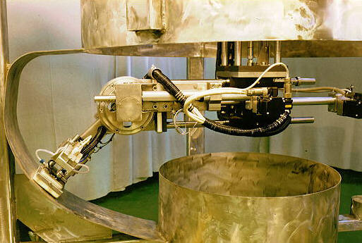
What Can Robots Do: I
Jobs that are dangerous for humans
Decontaminating Robot
Cleaning the main circulating pump housing in the nuclear power plant

Slide 8
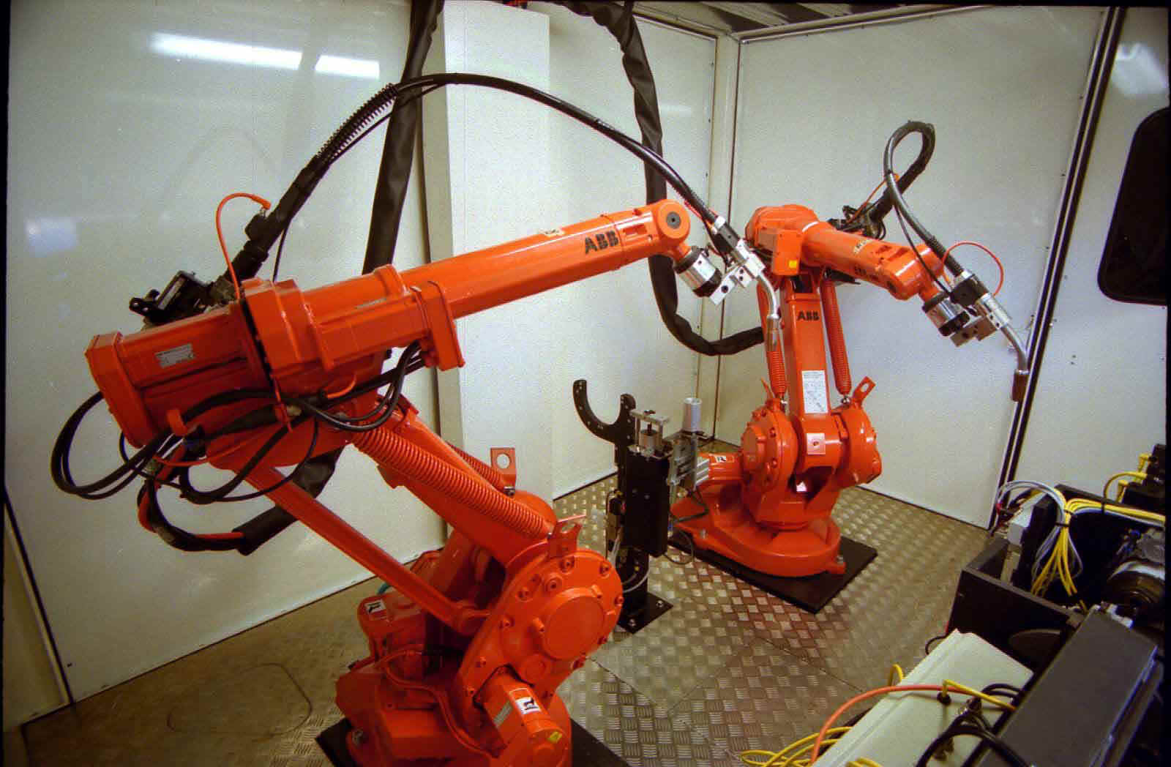
What Can Robots Do: II
Repetitive jobs that are boring, stressful, or labor-intensive for humans
Welding Robot

Slide 9
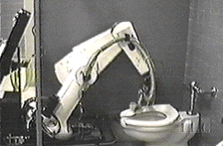
What Can Robots Do: III
Manual tasks that human don’t want to do
The SCRUBMATE Robot

Slide 10
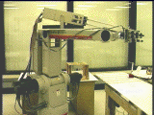
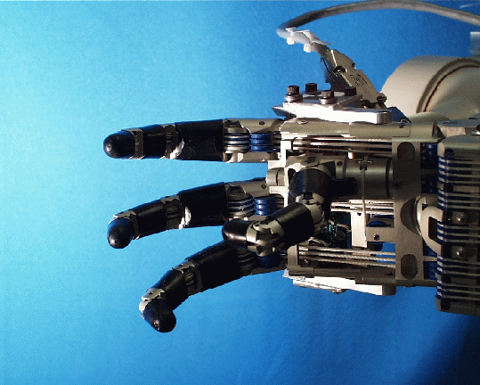
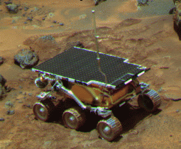
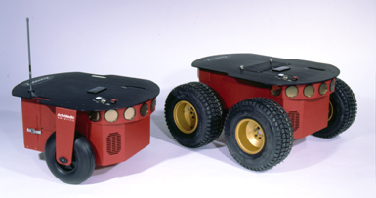
Robots
Robot Manipulators
Mobile Robots

Slide 11
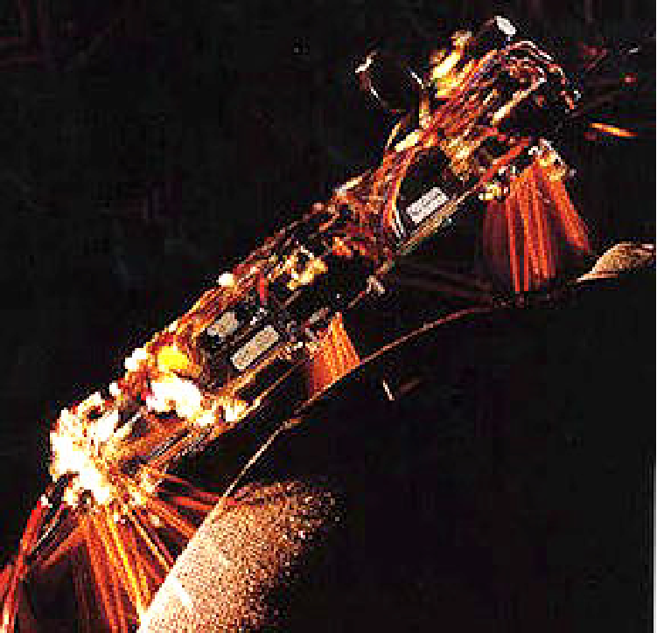
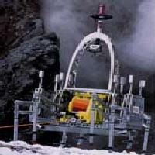
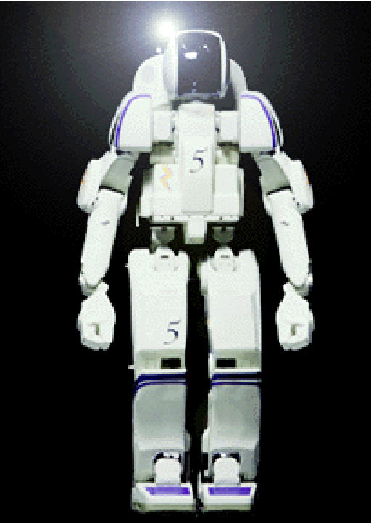
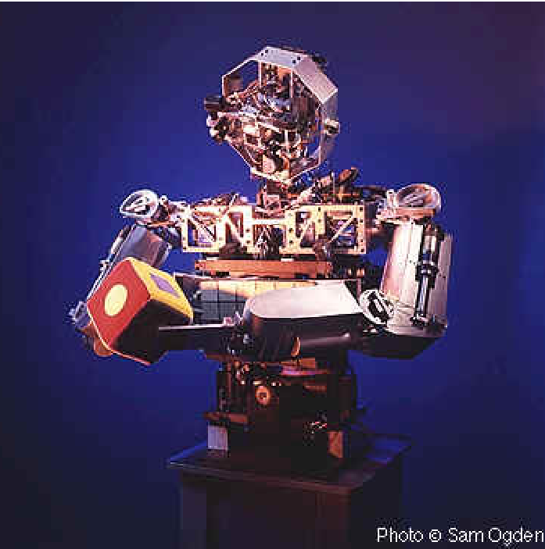
Robots
Walking Robots
Humanoid Robots

Slide 12
Automation and Robotics in Intelligent Environments
Control of the physical environment
Automated blinds
Thermostats and heating ducts
Automatic doors
Automatic room partitioning
Personal service robots
House cleaning
Lawn mowing
Assistance to the elderly and handicapped
Office assistants
Security services

Slide 13
Robots
Robota (Czech) = A worker of forced labor
From Czech playwright Karel Capek's 1921 play “R.U.R” (“Rossum's Universal Robots”)
Japanese Industrial Robot Association (JIRA) :
“A device with degrees of freedom that can be controlled.”
Class 1 : Manual handling device
Class 2 : Fixed sequence robot
Class 3 : Variable sequence robot
Class 4 : Playback robot
Class 5 : Numerical control robot
Class 6 : Intelligent robot

Slide 14
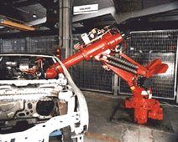
Traditional Industrial Robots
Traditional industrial robot control uses robot arms and largely pre-computed motions
Programming using “teach box”
Repetitive tasks
High speed
Few sensing operations
High precision movements
Pre-planned trajectories and
task policies
No interaction with humans

Slide 15
Requirements for Robots in Intelligent Environments
Autonomy
Robots have to be capable of achieving task objectives without human input
Robots have to be able to make and execute their own decisions based on sensor information
Intuitive Human-Robot Interfaces
Use of robots in smart homes can not require extensive user training
Commands to robots should be natural for inhabitants
Adaptation
Robots have to be able to adjust to changes in the environment

Slide 16
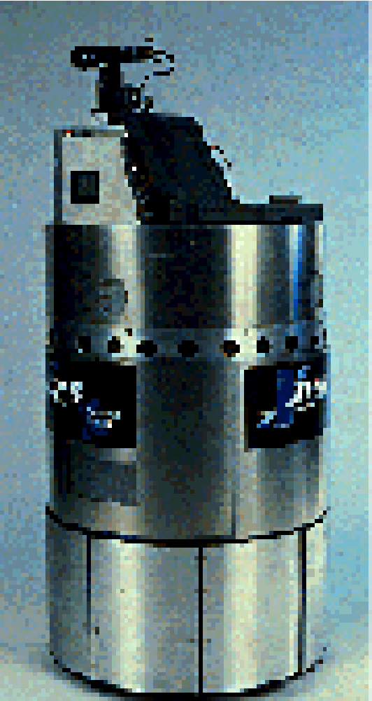
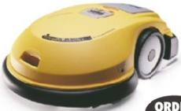
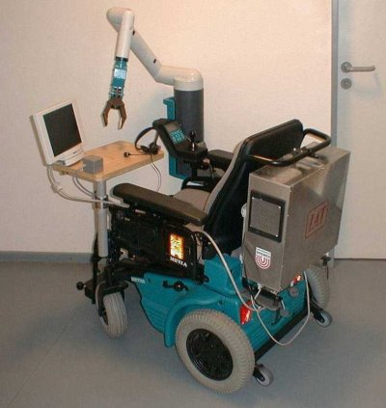
Robots for Intelligent Environments
Service Robots
Security guard
Delivery
Cleaning
Mowing
Assistance Robots
Mobility
Services for elderly and
People with disabilities

Slide 17
Classification of Robots
- JIRA (Japanese Industrial Robot Association)
Class1: Manual-Handling Device
Class2: Fixed Sequence Robot
Class3: Variable Sequence Robot
Class4: Playback Robot
Class5: Numerical Control Robot
Class6: Intelligent Robot

Slide 18
Classification of Robots
- RIA (Robotics Institute of America)
Variable Sequence Robot(Class3)
Playback Robot(Class4)
Numerical Control Robot(Class5)
Intelligent Robot(Class6)

Slide 19
Classification of Robots
- AFR (Association FranÇaise de Robotique)
Type A: Manual Handling Devices/ telerobotics
Type B: Automatic Handling Devices/ predetermined cycles
Type C: Programmable, Servo controlled robot,
continuous point-to-point trajectories
Type D: Same type with C, but it can acquire information.

Slide 20
What is Robotics?
Robotics is the art, knowledge base, and the know-how of designing, applying, and using robots in human endeavors.
Robotics is an interdisciplinary subject that benefits from mechanical engineering, electrical and electronic engineering, computer science, biology, and many other disciplines.

Slide 21
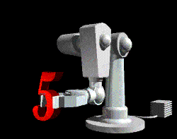
What are the parts of a robot?
Manipulator
Pedestal
Controller
End Effectors
Power Source

Slide 22
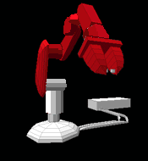
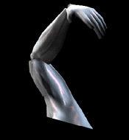
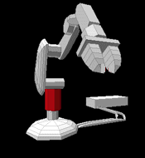
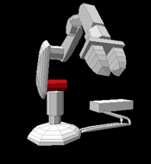
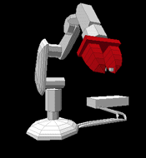
Manipulator
Base
Appendages
Shoulder
Arm
Grippers

Slide 23
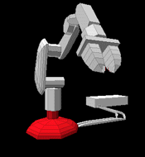
Pedestal
(Human waist)
Supports the manipulator.
Acts as a counterbalance.

Slide 24
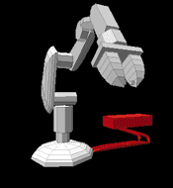
Controller
(The brain)
Issues instructions to the robot.
Controls peripheral devices.
Interfaces with robot.
Interfaces with humans.

Slide 25
End Effectors
(The hand)
Spray paint attachments
Welding attachments
Vacuum heads
Hands
Grippers

Slide 26
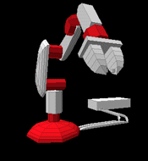
Power Source
(The food)
Electric
Pneumatic
Hydraulic

Slide 27
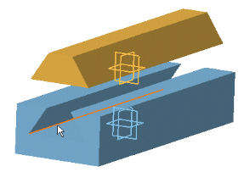
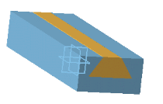
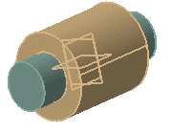
Robot Joints
Prismatic Joint: Linear, No rotation involved.
(Hydraulic or pneumatic cylinder)
Revolute Joint: Rotary, (electrically driven with stepper motor, servo motor)

Slide 28
Robot Coordinates
Fig. 1.4
• Cartesian/rectangular/gantry (3P) : 3 cylinders joint
• Cylindrical (R2P) : 2 Prismatic joint and 1 revolute joint
• Spherical (2RP) : 1 Prismatic joint and 2 revolute joint
• Articulated/anthropomorphic (3R) : All revolute(Human arm)
• Selective Compliance Assembly Robot Arm (SCARA):
2 paralleled revolute joint and 1 additional prismatic joint

Slide 29
Robot Reference Frames
Fig. 1.6 A robot’s World, Joint, and Tool reference frames.
Most robots may be programmed to move relative to either of these reference frames.

Slide 30
Robot Workspace
Fig. 1.7 Typical workspaces for common robot configurations

Slide 31
ROBOT CHARACTERISTICS
Payload
Payload is the weight a robot can carry
Reach
Reach is the maximum distance a robot can reach within its work envelope.
Precision
Precision is defined as how accurately a specifies point can be reached
Repeatability
Repeatability is how accurately the same position can be reached if the motion is repeated many times.
http://www.directindustry.com/prod/yamaha-motor-industrial-robots/product-25092-56426.html#video

Slide 32
♦ Robot Application
Machine loading
Pick and place operations
Welding
Painting
Sampling
Assembly operation
Manufacturing
Surveillance
Medical applications
Assisting disabled individuals
Hazardous environments
Underwater, space, and remote locations

Slide 33
History of Robotics - The Origins of Robots
≈250 B.C. - Ctesibius, an ancient Greek engineer and mathematician, invented a water clock which was the most accurate for nearly 2000 years.
≈60 A.D. – Hero of Alexandria designs the first automated programmable machine. These 'Automata' were made from a container of gradually releasing sand connected to a spindle via a string. By using different configurations of these pulleys, it was possible to repeatably move a statue on a pre-defined path.

Slide 34
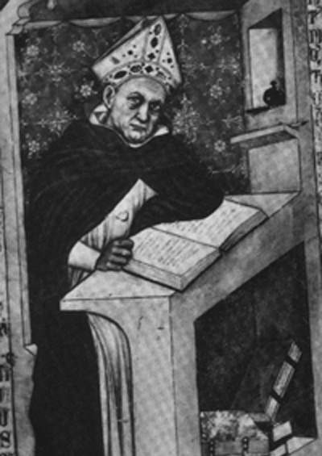
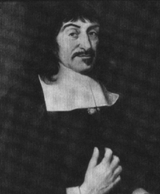
History of Robotics - The Origins of Robots
≈ 1250 - Bishop Albertus Magnus holds banquet at which guests were served by metal attendants. Upon seeing this, Saint Thomas Aquinas smashed the attendants to bits and called the bishop a sorcerer.
1640 - Descartes builds a female automaton which he calls “Ma fille Francine.” She accompanied Descartes on a voyage and was thrown overboard by the captain, who thought she was the work of Satan.

Slide 35
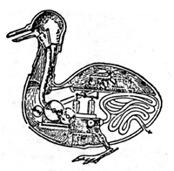
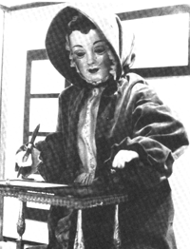
History of Robotics - The Origins of Robots
1738 - Jacques de Vaucanson builds a mechanical duck made of more that 4,000 parts. The duck could quack, bathe, drink water, eat grain, digest it and void it. Whereabouts of the duck are unknown today.
1805 - Doll, made by Maillardet, that wrote in either French or English and could draw landscapes.

Slide 36

History of Robotics - The Origins of Robots
1898 - The first radio-controlled submersible boat was invented by Nikola Tesla.
1921 - The term "robot" was first used in 1920 in a play called "R.U.R." Or "Rossum's universal robots" by the Czech writer Karel Capek. The plot was simple: man makes robot then robot kills man! Many movies that followed continued to show robots as harmful, menacing machines. Robot comes from the Czech word robota, which means “servitude, forced labor.”

Slide 37


History of Robotics - The Origins of Robots
Robotics was first introduced into our vocabulary by Czech playwright Karel Capek in his 1920’s play Rossum’s Universal Robots.
The word “robota” in Czech means simply work. Robots as machines that resemble people, work tirelessly, and revolt against their creators. .
The same myth/concept is found in many books/movies today:
“Terminator”, “Star-Wars” series.
Mary Shelley’s 1818 Frankenstein.
Frankenstein & The Borg are examples of “cybernetic organisms”.
Karel Capek

Slide 38
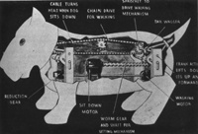

History of Robotics
1940 - Sparko, the Westinghouse dog, uses both mechanical and electrical components.
1941 - Isaac Asimov introduced the word 'Robotics' in the science fiction short story 'Liar!‘
1948 - William Grey Walter builds Elmer and Elsie, two of the earliest autonomous robots with the appearance of turtles. The robots used simple rules to produce complex behaviors.
Cybernetics is a discipline that was created in the late 1940’s by Norbert Wiener, combining feedback control theory, information sciences and biology to try to explain the common principles of control and communications in both animals and machines.

Slide 39
History of Robotics
1950`s - Computer technology advances and control machinery is developed.
Questions Arise: Is the computer an immobile robot?
1954 - The first silicon transistor was produced by Texas Instruments.
1954 – George Devol replaced the slave manipulator in a teleoperator with the programmability of the CNC controller, thus creating the first “industrial robot”, called the “Programmable Article Transfer Device”.

Slide 40
History of Robotics
1955 – The Darmouth Summer Research Conference marks the birth of AI. Marvin Minsky, from the AI lab at MIT defines an intelligent machine as one that would tend to “build up within itself an abstract model of the environment in which it is placed. If it were given a problem, it could first explore solutions within the internal abstract model of the environment and then attempt external experiments”. This approach dominated robotics research for the next 30 years.
1956 - Researchers aim to combine “perceptual and problem-solving capabilities,” using computers, cameras, and touch sensors. The idea is to study the types of intelligent actions these robots are capable of. A new discipline is born: A.I.

Slide 41
History of Robotics
1956 - Joseph Engleberger, a Columbia physics student buys the rights to Devol’s robot and founds the Unimation Company.
1956 - George Devol applied for a patent for the first programmable robot, later named 'Unimate'.
1957 - Launch of the first artificial satellite, Sputnik 1.

Slide 42
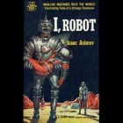
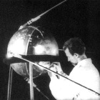
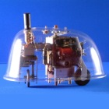
History of Robotics
I, Robot
Sputnik I
Turtle robot

Slide 43
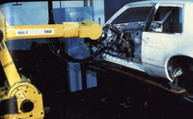
History of Robotics
1960`s - Industrial Robots created. Robotic Industries Association states that an “industrial robot is a re-programmable, multifunctional manipulator designed to move materials, parts, tools, or specialized devices through variable programmed motions to perform a variety of tasks”.
Robot Institute of America, 1979

Slide 44
History of Robotics
1961 - The first Unimate robot is installed in a Trenton, NJ General Motors plant to tend a die casting machine. The key was the reprogrammability and retooling of the machine to perform different tasks. The Unimate robot was an innovative mechanical design based on a multi-degree of freedom cantilever beam. The beam flexibility presented challenges for control. Hydraulic actuation was eventually used to alleviate precision problems.
1962 – 1963 – The introduction of sensors is seen as a way to enhance the operation of robots. This includes force sensing for stacking blocks (Ernst, 1961), vision system for binary decision for presence of obstacles in the environment (McCarthy 1963), pressure sensors for grasping (Tomovic and Boni, 1962). Robot interaction with an unstructured environment at MIT’s AI lab (Man and Computer – MAC project).

Slide 45
History of Robotics
1965 - Gordon E. Moore introduces the concept 'Moore's law', which predicts the number of components on a single chip would double every two years.
1966 – 1968 'Shakey‘, a mobile robot is developed by SRI (Stanford Research Institute). 'Shakey' was capable of planning, route-finding and moving objects. It was placed in a special room with specially colored objects. A vision system would recognize objects and pushed objects according to a plan. This planning software was STRIPS, and it maintained and updated a world model. The robot had pan/tilt and focus for the camera, and bump sensors.
1968 – Kawasaki Heavy Industries in Japan acquires a license for Unimate.
1969 - The Apollo 11 mission, puts the first man on the moon. Landing was made inside the Lunar Module 'Eagle'.

Slide 46
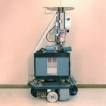
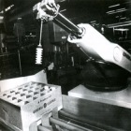
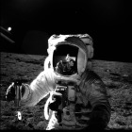
History of Robotics
Unimate 1
Shakey
Moon Walk
Notes:
Information and pictures from the previous five slides can be found in Isaac Asimov’s and Karen A. Frenkel’s book “Robots, Machines in Man’s Image ” © 1985

Slide 47
History of Robotics
1970 - Luna 17 lands on the moon, carrying the roving remote-controlled robot, Lunokhod 1.
1971 - Intel introduce the first commercially available microprocessor, the 4004.
1971 -1973 – The Stanford Arm is developed, along with the first language for programming robots - WAVE.
1972 – First snake-like robot – ACM III – Hirose – Tokyo Inst. Of Tech.
1970’s – JPL develops its first planetary exploration Rover using a TV camera, laser range finder and tactile sensors.
1975 - The space probes Viking 1 and 2 were launched each with an articulated robot arm.
1976 - The film Star Wars is released introducing R2-D2 and C-3PO.

Slide 48
History of Robotics
1977 – Development of mobile robot Hilaire at Laboratoise d’Automatique et d’Analyse des Systemes (LAAS) in Toulouse, France. This mobile robot had three wheels and it is still in use.
Two famous robots:
1978- Puma (Programmable Universal Machine for Assembly), by Unimation.
1979 - SCARA (Selective Compliant Articulated Robot for Assembly) introduced in Japan and the US (by Adept Technologies).

Slide 49





History of Robotics - PUMA

Slide 50





History of Robotics - SCARA

Slide 51
History of Robotics
1980’s – Innovation in improving the performance of robot arms – feedback control to improve accuracy, program compliance, the introduction of personal computers as controllers, and commercialization of robots by a large number of companies: KUKA (Germany), IBM 7535, Adept Robot (USA), Hitachi, Seiko (Japan).
Early 1980’s – Multi-fingered hands developed, Utah-MIT arm (16 DOF) developed by Steve Jacobsen, Salisbury’s hand (9 dof).
1977-1983 – Stanford cart/CMU rover developed by Hans Moravec, later on became the Nomad mobile robot.

Slide 52
History of Robotics
1980’s – Legged and hopping robots (BIPER – Shimoyama) and Raibert 1986.
1984 -1991 – V. Braitenberg revived the tortoise mobile robots of W. Grey Walter creating autonomous robots exhibiting behaviors. Hogg, Martin and Resnick at MIT create mobile robots using LEGO blocks (precursor to LEGO Mindstorms). Rodney Brooks at MIT creates first insect robots at MIT AI Lab – birth of behavioral robotics.

Slide 53
History of Robotics
1986 - Honda starts work on its first humanoid, robot named 'E0' (later to become ASIMO).
1988 - SCAMP designed as the first robot pet with emotions.
1989 - Mark Tilden introduces BEAM robotics, beam being an acronym for Biology, Electronics, Aesthetics, and Mechanics.
‘90: modifiable robots for assembly. Mobile autonomous robots. Vision controlled robots. Walking robots.
1991 - First HelpMate mobile autonomous robot used in hospitals.

Slide 54
History of Robotics
1990’s – Humanoid robots – Cog, Kismet (MIT), Wasubot, WHL-I – Japan, Honda P2 (1.82m, 210kg), and P3 (1.6m, 130kg), ASIMO.
1990’s – Entertainment and Education Robots – SARCOS (“Jurassic Park”), Sony AIBO, LEGO Mindstorms, Khepera, Parallax.
ROBOCUP, the competition simulating the game of soccer played by two teams of robots having been held around the world since 1997 (Osaka) .

Slide 55
History of Robotics
1997 - Sojourner becomes the first rover to land on Mars as part of the Mars Pathfinder mission.
1998 - Lego enters the robotics market with its first version of Lego Mindstorms.
1999 - Sony introduces AIBO, an autonomous robotic dog capable of seeing, walking and interacting with its environment. This was followed a year later by the SDR-3X humanoid robot later known as QRIO (both discontinued in 2006).

Slide 56
History of Robotics
1990’s – Introduction of space robots (manipulators as well as rovers – the MARS rover 1996), parallel manipulators (Stewart-Gough Platforms), multiple manipulators, precision robots (“Robotworld”), surgical robots (“RoboDoc”), first service robots (as couriers in hospitals, etc)

Slide 57
History of Robotics
2000 - Honda unveils ASIMO, the first non-prototype release of its humanoid robot.
2001 - US Air force test the MQ-1 Predator, the first armed unmanned aerial vehicle (UAV) fitted with two Hellfire missiles.
2000’s – IRobot introduces the first autonomous vacuum – “Roomba”.
2000’s – Mini and micro robots, “Smart Dust” – Pister @ Berkeley, UTA, EPFL/Lausanne, microfactories.

Slide 58
History of Robotics
2000’s – Military applications - Robotic assistants for dangerous environments and reconnaissance, AUV’s and UUV’s, etc.
2000’s – Intuitive Surgical introduces the Da Vinci surgical robot.
2000’s – Robotic Deployment of Sensor Networks

Slide 59






History of Robotics
Lunokhod 1 Intel 4004 R2-D2 and C-3PO
Asimo Sojourner Lego Mindstorms

Slide 60



History of Robotics
Sony AIBO
MQ-1 Predator
Sony QRIO

Slide 61
History of Robotics
2002 - iRobot introduces Roomba, a personal robotic vacuum cleaner.
2003 - Osaka University unveils their first 'Actroid', the term given for a humanoid robot with strong visual human characteristics.
2004 - The first DARPA Grand challenge is help. Sponsored by the US department of defence, the challenge is designed to create autonomous vehicles for warfare.
2004 - The Mars rovers Spirit and Opportunity land on Mars. As of November 25th 2009 The rover Spirit has completed 2150 days of its 92 day (90 sol) mission.
2010 - NASA and General Motors join forces to develop Robonaut-2, the new version of NASA's humanoid robot astronaut.

Slide 62



History of Robotics
Actroid
Robonaut-2
Mars Exploration Rover

Slide 63

History of Robotics
Should robots look like humans? “anthropomorphic or humanoid robots”.
Need for these machines to also be intelligent - link to “Artificial Intelligence (AI)”.
Need for humans to create machines similar to them is rooted in religious beliefs, recommended reading “God in the Machine” by Anne Foerst
It is not the appearance of the robot that most connects it to humans: HAL in “Space Odyssey 2001”, Lt. Data in “Startrek-TNG”, R2D2 and C3PO in “Star Wars”. Which one is more “likeable” and why?

Slide 64
History of Robotics
Robots need not look like humanoids, but they make use of:
Strong & precise articulated arms to accomplish tasks that were performed by humans – “articulated robots”, or “manipulators”. Fear that they will replace human laborers.
Use of mobility to reposition the robot from one location to another, “mobile robots”. This can be done by locomotion like humans do (“legged robots”), but most likely it will use other means such as wheels (“wheeled robots”).

Slide 65
History of Robotics
Robotics is a multi-disciplinary field. Best robotics researchers and engineers will touch upon all disciplines:
Mechanical Engineering – concerned primarily with manipulator/mobile robot design, kinematics, dynamics, compliance and actuation.
Electrical Engineering – concerned primarily with robot actuation, electronic interfacing to computers and sensors, and control algorithms.
Computer Science – concerned primarily with robot programming, planning, and intelligent behavior.

